Slide 1

Medway Public Schools
Preliminary FY21 Budget Discussion
February 27, 2020
Armand Pires, Ph.D., Superintendent
Donald Aicardi, Director of Finance and Operations

Slide 2
Tonight’s Goals
Present FY 21 budget needs
Broad overview of FY21 budget priorities
Share the recommended efficiencies in FY21
Share the recommended improvements in FY21

Slide 3
FY21 Budget Development Strategies
Ensure a budget connected to identified Strategic Plan Goals
Ensure a budget that meets the needs of students
Ensure transparent budget development and a collaborative process
Acknowledge community and town leadership support of our schools
Ensure initiative implementation timelines that are reasonable
Review current available funding resources to identify potential efficiencies
Ensure budget includes new obligations connected to Student Opportunity Act

Slide 4
Strategic Plan Goals
#1 Goal: Improved Student Learning:
Improve the learning of all.
Goal #2: Social / Emotional Wellness:
Foster the social, emotional, and healthy development of all.
Goal #3: Innovative Teaching and Leadership:
Ensure best practices and encourage innovation in teaching and leading.
Goal #4: Positive Learning Culture:
Cultivate a school, student, and professional culture that values trust, collaboration, and effective communication.

Slide 5
  Student Enrollment and Staffing:
  Historical Perspective

Slide 6
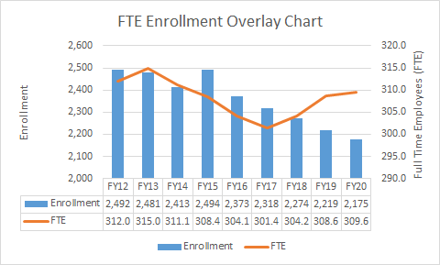
Medway Public Schools Enrollment

Slide 7
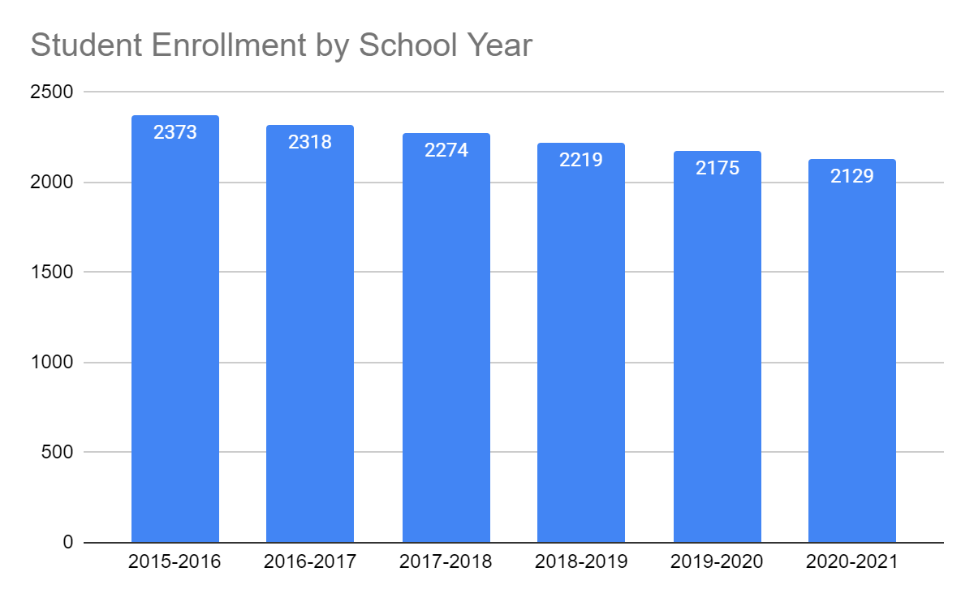
Medway Schools:
Enrollment History and Projection, K-12
Notes:
Add detailed enrollment by school here:

Slide 8
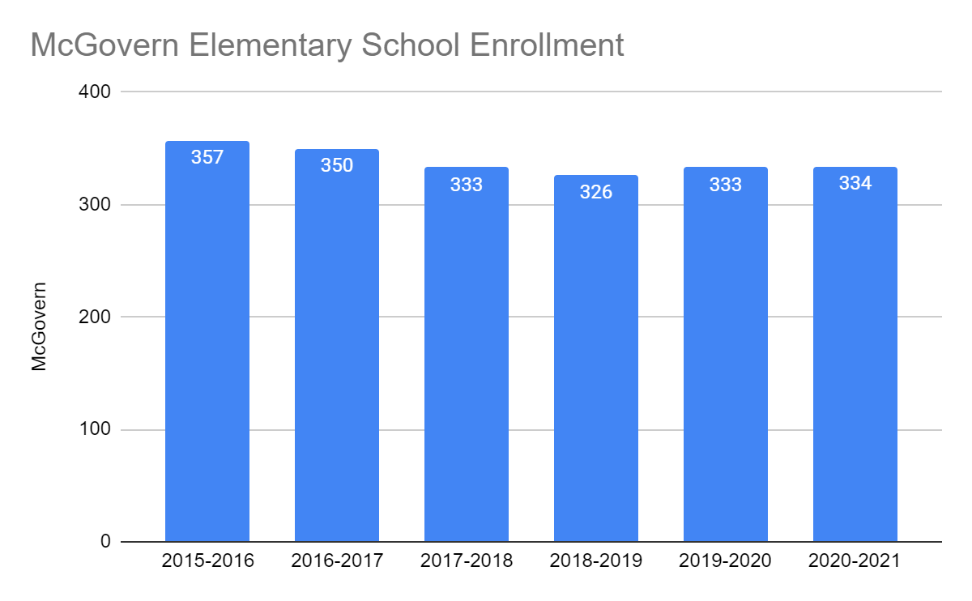
McGovern Elementary School:
Enrollment History and Projection

Slide 9
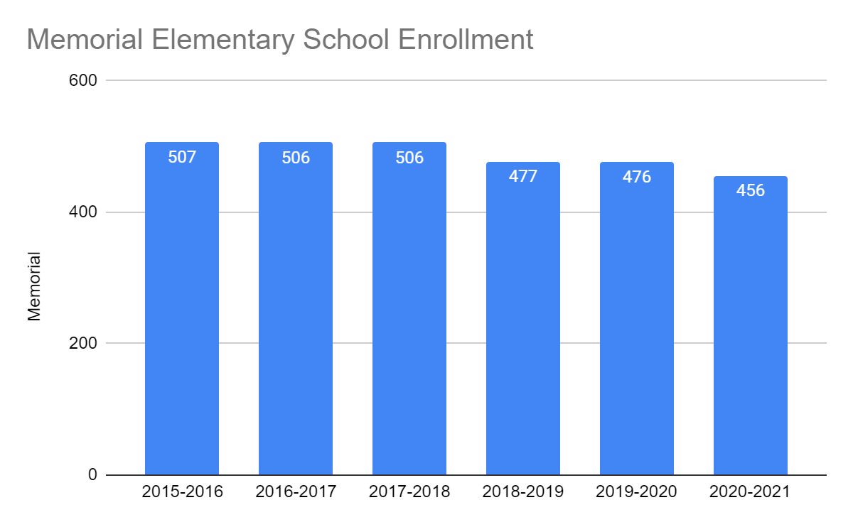
Burke-Memorial Elementary School:
Enrollment History and Projection

Slide 10
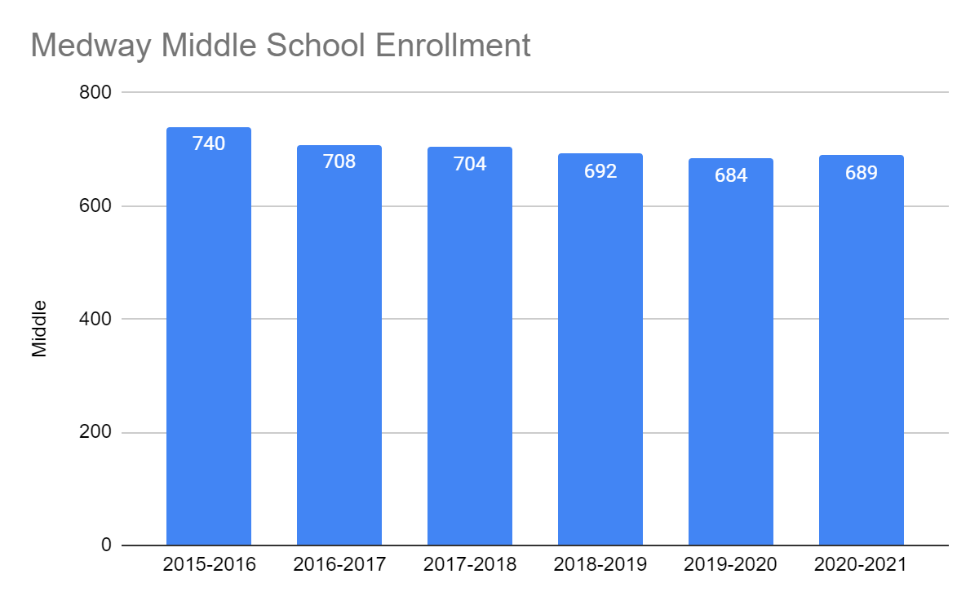
Medway MIddle School:
Enrollment History and Projection

Slide 11
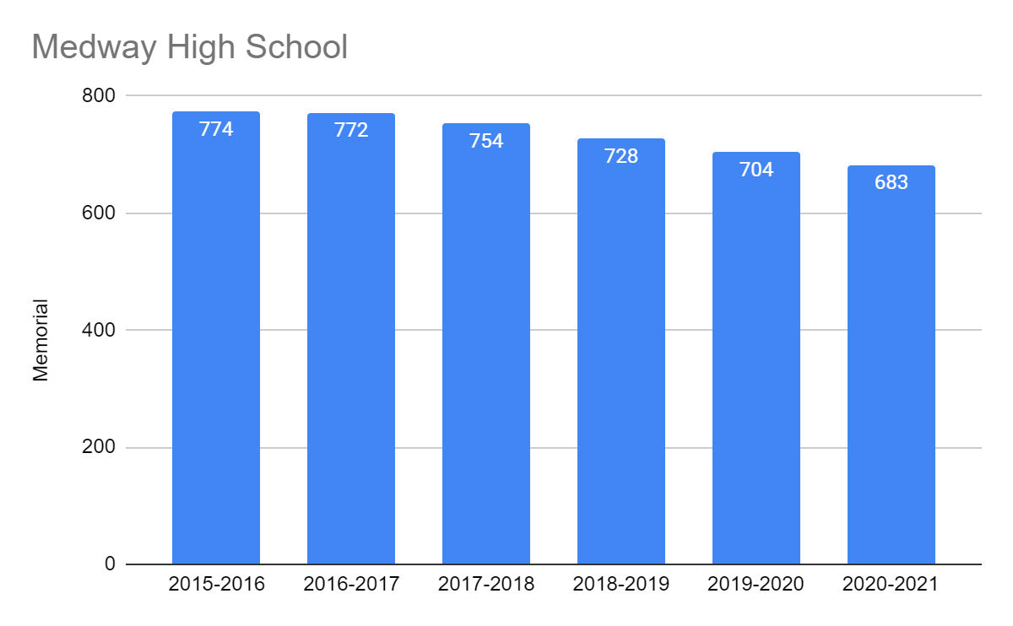
Medway High School:
Enrollment History and Projection

Slide 12
Projected Class Size 2020-2021
FTE Implications
Grade | Current Enrollment | # of Classes | Average Class Size | Projected Enrollment | # of Classes | Average Class Size | Change
PreK | 35 | 4 sections | 7/8=15⁺ | 36 | 4¹ sections |  | 0
K | 146 | 8 | 18 | 145² | 8 | 18 | 0
1 | 149 | 8 | 19 | 145 | 8 | 19 | 0
2 | 154 | 8 | 20 | 149³ | 7 | 21 | -1.0FTE
3 | 151 | 8 | 19 | 154 | 8 | 19 | 0
4 | 171 | 8 | 21 | 151 | 8 | 19 | 0
¹Preschool sections reflect: # student IEPs/ # typical peers = total number of students per section.
Each Integrated Preschool section should have no more than 15 students (7/8).
²Prediciting K enrollment can be challenging.
³Enrollment projections predict smaller grade levels

Slide 13
Projected Class Size 2020-2021
FTE Implications, cont’d.
Grade | Current Enrollment | # of Classes | Average Class Size | Projected Enrollment | # of Classes | Average Class Size | Change
5 | 161 | 8 | 20 | 171 | 8 | 21 | 0
6 | 186 | 8 | 23 | 161 | 8 | 20 | 0
7 | 171 | 8 | 21 | 186 | 8 | 23 | 0
8 | 166 | 10 | 21 | 171 | 10 | 21 | 0
9-12* | 682 | N/A | N/A | 659 | N/A | N/A | -2 FTE
Total | 2318 |  |  | 2289 |  |  | -3.0FTE
*Continuing declining enrollment, along with improved efficiency of scheduling warrant reduction

Slide 14
Funding the Medway Public Schools

Slide 15
Multiple Funding Sources
Chapter 70 Aid
State and Federal Grants (IDEA Grant)
Circuit Breaker
School Choice

Slide 16
FY21 Level Service Development
Revenue Sources That Are Used Each Year To supplement the budget:
Circuit Breaker (was $583,279 in FY20)
IDEA Grant (was $553,877 in FY20)
ACCEPT Tuition Waiver Credit (was $109,000 in FY20) School Choice (was $356,955 in FY20)
Vacancy Factor? (was $76k in FY20)
Community Ed Support (was $26k in FY20; new in FY19)

Slide 17
Medway Public Schools
Chapter 70 Allocations
 | Chapter 70 | $ Increase | % Inc
FY14 | $10,058,469 | $60,525 | .61%
FY15 | $10,117,244 | $58,775 | .58%
FY16 | $10,175,519 | $58,275 | .58%
FY17 | $10,301,469 | $125,950 | 1.2%
FY18 | $10,368,909 | $67,440 | .65%
FY19 | $10,434,849 | $65,940 | .63%
FY20 | $10,501,419 | $66,570 | .63%
FY21 (Governor’s) | $10,566,999 | $65,580 | .62%
‹#›

Slide 18
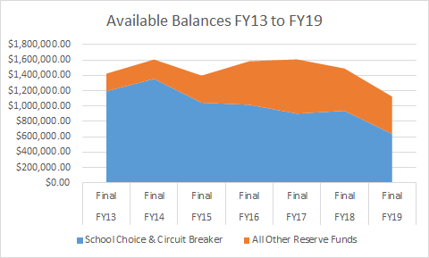
FY13 to FY19 Review of Medway School Department Reserves

Slide 19
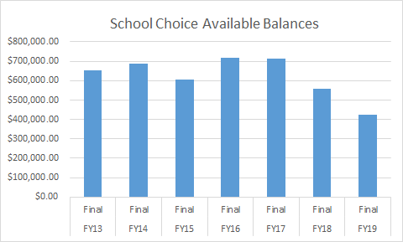
School Choice
SC has authorized $2.4 million from School Choice from FY15 to FY20 Budgets for annual budget support, projects and materials
FY21 Revenue is expected to be $325,000 for 65 students, excluding reimbursement for special education expenses
FY21 Budget Support From School Choice Currently At $350,000

Slide 20
Medway Public Schools
Annual % Increase to General Fund Budget
 | Operating Budget | $ Increase | % Inc
FY16 | $24,896,185 | $309,369 | 1.3%
FY17 | $25,341,066 | $444,674 | 1.8%
FY18 | $25,865,998 | $524,932 | 2.1%
FY19 | $26,966,000 | $1,100,002* | 4.25%
FY20 | $27,666,000 | $700,000 | 2.6%
FY21 | $28,490,125 | $824,125 | 3%
* Includes $500K from Exelon agreement targeted for Tuition Free KG

Slide 21
Our Starting Point:
Calculate Level Service

Slide 22
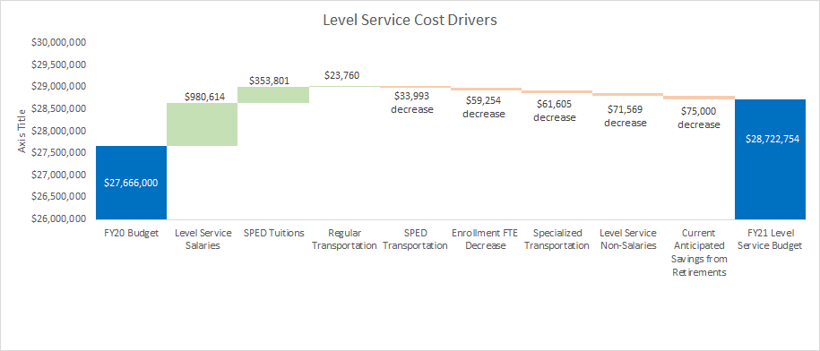
FY21 Level Service Development

Slide 23
FY21 Level Service Development
Started with current staffing levels (beginning in Nov. 2019)
Estimated Increased Payroll Costs Including collective bargaining agreements $980,614
(FY21 represents third year of three year collective bargaining agreements)
Lowered Vacancy Factor $73,624 to $0
Assumed 3 Retirements ($75,000)
Initial Review Yielded one FTE Decrease ($59,254)
Reviewed all changes from reconfigured FY20 budget (from Fall, 2019)

Slide 24
FY21 Level Service Development
Estimated Total SPED Tuition $353,801
Reviewed all next year’s placements-some increase are known & the rest were estimated at a 2% increase in FY21
CONTEXT: FY20 to FY21 Budgetary Increase must be seen in context of FY20 budget proved to be too low- increase not from large increase in numbers of tuitions
Reviewed all transportation accounts in total:
Regular Transportation $23,760
Specialized Transportation ($61,505)
SPED Transportation ($33,993)

Slide 25
FY21 Level Service Development
Reviewed All Other Non-Salary Accounts: ($71,569)
Highlights:
school cleaning (3 year contract concluding with FY21)
bus transportation (3 year contract concluding with FY21)
natural gas (October 2019 to September 2021; will conclude in middle of FY22)
electricity (December 2017 to December 2020; will conclude in middle of FY21)
water/sewer (10% increase) & trash rate (no increase) as requested by Medway Municipal officials

Slide 26
FY21 INITIAL Level Service
Final FY20 Budget: $27,666,000 FY21 Initial Level Service: $28,722,754
Our initial Level Service estimate represented an increase of approximately $1,056,754, but did not include improvement initiatives, efficiencies, or final estimates

Slide 27
FY21 Initial Level Service: $28,722,754
Level Service increase estimate was $1,056,754, but did not include improvement initiatives, efficiencies, or final estimates:
Budget Efficiencies/Refinements ($45,963)
Shift Expenses Revolving Funds (Comm Ed & Custodian RF) ($35,312)
Increase Circuit Breaker $100k From First Estimate ($100,000)
Decrease FTEs Due To Enrollment ($231,510)
FY21 Budget Efficiencies/Changes: ($412,629)

Slide 28
FY21 Initial Level Service: $28,722,754
Level Service increase estimate: $1,056,754
FY21 Budget Efficiencies/Changes: ($412,629)
Athletic Increase $40,000
SPED Van Drivers $50,000
K-2 Science/Technology/Engineering Teachers $58,000
Burke/Memorial Social Worker $32,000
FY21 Improvement Requests: $180,000

Slide 29
Impact of Identified Efficiencies and Improvements on FY21 Preliminary Budget
Starting Point: Level Service: $1,056,754
Staffing Efficiencies/Budget Changes: ($412,629)
Improvement Requests: $180,000
Total FY21 Increase Over FY20: $824,125
or 3% increase
FY21 Preliminary Budget Is Currently $114,125 Higher Than
Board Of Selectmen FY21 $710,000 Recommended Budget

Slide 30
Medway Public Schools
FTEs Funded by Town Meeting Appropriation (FY16-FY21)
 | FTEs | Variance
FY16 | 304.1 | (-3.4)
FY17 | 301.4 | (-2.7)
FY18 | 304.2 | +2.8
FY19 | 308.8 | +4.6
FY20 Final | 312.9 | +4.1
FY21 Recommended | 313.0 | +.1*
*The addition of four (4) building based Paras into the Paraprofessional salary accounts that were funded as part of the FY20 Reconfigured Budget led to a recommended $74k reduction in the FY21 2325 Short Term Substitute Account-it was estimated as part of the FY21 Level Service calculation.

Slide 31
FY21 Improvement Efforts

Slide 32
FY21 Budget Priorities Overview
Improving Content Area Expertise and Time on Learning
(#1 Goal, Goals 3 and 4)
Ensure Curriculum Alignment (#1 Goal)
Meet the Unique Needs of Students (#1 Goal, Goals 2 and 3)
Ensure fiscal support of the athletic program (Goal 4)

Slide 33
FY21 Budget Improvement Requests
Add grade K-2 Science, Technology, Engineering Teacher (similar to model that exists in Grades 3 and 4) $58,000
Procure core curriculum resources to support:
  K-8 Mathematics
  Grade 6 and 7 History/Social Sciences
  Honors/AP US History
  Tier 2 Mathematics, K-8
  Advanced training in Responsive Classroom philosophy

Slide 34
FY21 Budget Improvement Requests
Procure 2 district operated mini-vans (Funding TBD)
Add 2 Mini-Van Drivers $50,000
Membership, The Education Cooperative Collaborative $15,000
Add 1.0 Elementary Science Specialist $58,000
Add 1.0 School Social Worker $32,000
Increase general fund to support athletics $40,000
Notes:
(Offset by $15k decrease in TEC FY21 Placements)
Athletic fees increased for next year, approved by SC
(up to $60,000 in FY21 from $0 in FY19)

Slide 35
FY21 Budget Increase Summary

Slide 36
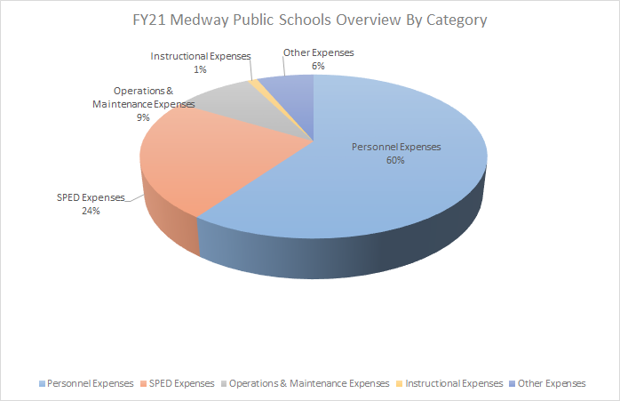
FY21 Preliminary Budget

Slide 37
Review of Medway Public School Expenses Embedded In Medway Municipal Budget

Slide 38
Municipal Budget Support
Expenses that reside within sections of the municipal budget that count towards Net School Spending formula-received by Town Finance staff each year:
Treasurer/Accountant ($130k in FY19 EOYR)
Operations/Parks (Snow/Ice) ($193k in FY19 EOYR)
Health Insurance & Life ($3.51m in FY19 EOYR)
Workers Compensation ($122k in FY19 EOYR)
Medicare ($371k in FY19 EOYR)
County Retirement ($1,392,630 in FY19 EOYR)
Liability Insurance ($59,656 in FY19 EOYR)
Crossing Guards ($40,057 in FY19 EOYR)
Debt Service Payments ($2,168,207 in FY19 EOYR) DOES NOT COUNT FOR NSS
Assessments (separate from school operating budget):
        Tri-County $790,474 in FY19 EOYR DOES COUNT FOR NSS
        School Choice Assessment $329,393 in FY19 EOYR
        Charter School $205,080 in FY19 EOYR DOES COUNT FOR NSS
TOTAL FROM FY19 INCLUDED IN EOYR CALCULATION: $10,161,702

Slide 39
Municipal Budget Support
Expenses that reside within sections of the municipal budget that count towards Net School Spending formula-received by Town Finance staff each year:
$819,290 For Projects Approved From FY20 Capital Articles (number reported in FY19 EOYR)
$211,163 For School Technology Approved From FY20 Capital Articles (number reported in FY19 EOYR)
Staffing support for School Department also located in Town’s Budget for Technology (Director of Information Services & Network Engineer) and Human Resources Coordinator

Slide 40
Medway Public Schools Financial Overview/Timeline
November, 2019/January, 2020: Staffing levels/operating budget requests reviewed
November, 2019/December, 2019 Educational Leadership Team FY21 Staffing Needs Meetings
January 30, 2020: School Committee Budget Workshop
February 6, 2020: “Charting The Course” FY21 Budget Planning Presentation
February 27, 2020: FY21 Preliminary budget presented to Medway School Committee
March 5, 2020 School Committee FY21 Budget Public Forum
March 11, 2020: Medway Finance Committee Presentation
March 19, 2020: School Committee Budget Public Hearing
March 19, 2020: School Committee Vote on Budget
May 11, 2020: Annual Town Meeting approval
November, 2020: FY21 “Re-Configured” budget published

Slide 41
FY21 Budget Request
$28,490,125
3% increase over FY20 Budget

Slide 42
Questions/Discussion

Slide 43
Back Up Material/Appendices

Slide 44
Medway Public Schools
FTEs Changes (FY20-FY21)
 | FTEs
FY20 Base | 312.9
FY21 Base
Redeploy/Enrollment: | (-3.6)
Improvement Requests: | 3.5
Staff Finalization: | .2
FY21 Requested | 313.0

Slide 45
FY21 Budget Account Detail

Slide 46
Medway Public Schools
FY21 Estimate-9300 Tuition Private Day Total
 | FY20 Final | FY21 Current
SPED Tuition (Private Day) | $1,206,704 | $1,389,686
Application-Circuit Breaker | ($583,279) | ($599,454)
Application-IDEA Grant | ($553,877) | ($567,024)
Application-School Choice | $0 | ($113,242)
SPED Tuition (Residential) | $356,955 | $236,658
Application-School Choice | ($356,955) | ($236,658)
SPED Tuition (Summer Day) | $0 | $0
TOTAL | $69,548 | $109,866

Slide 47
School Choice & Circuit Breaker:
Two Different Types Of Reserves
That Support Our Budget

Slide 48
School Choice Funds
“Incoming” School Choice revenue received every month from other school districts and directed to the MPS by the Commonwealth ($365,000 projected in FY20)
“Incoming” revenue goes into the School Choice Rev Fund
“Outgoing” expenses are incurred by the Town of Medway on a monthly basis to repay other school districts. Expenses do not come out of MPS budget; taken off the top by Medway Municipal budget allocation at beginning of budget process (most to Holliston and Millis)
We have been using it in the last several budgets to supplement the MPS annual budget ($260,000 in FY15 through FY17; $467,000 in FY18; $360,000 in FY19, $356,955 in FY20)
School Committee approval required for items and requests throughout the school year

Slide 49
‹#›
MPS School Choice Balances
FY | Medway
FY13 Final | $650,939
FY14 Final | $688,024
FY15 Final | $604,842
FY16 Final | $719,750
FY17 Final | $715,207
FY18 Final | $557,811
FY19 Final | $424,877
FY20 Projected | $402,300
‹#›

Slide 50
Circuit Breaker
Reimbursement from state for special education costs that exceed 4 times the average student foundation budget per pupil Ex: $60,000 - ((4 x$10,498)) * .70 = $12,604 reimb
75% final rate reimbursement -FY20 (65% in FY18; 72% in FY19)
Many districts have committed 100% funds received from Circuit Breaker in the same year received - Medway has not yet
If we did, it would leave no capacity for unexpected expenses in OOD tuition
Deliberate to carry over balances for financial stability
If not used, Circuit Breaker balance can be carried forward, but must be used by the close of the succeeding fiscal budget year
A large OOD bill could significantly erode the carryover balance in any year, at any time
Only used for any special education related purposes
Notes:
E)
FY04 FY05 FY06 FY07 FY08 FY09 FY10 FY11 FY12 FY13 FY14 FY15
75.00% 75.00% 75.00% 75.00% 75.00% 72.00% 42.34% 43.66% 68.71% 70.00% 73.5% 73%

Slide 51
‹#›
Circuit Breaker Available Funding
(One YE Balance Flows Into The Next)
FY | Medway
For FY14 | $542,633
For FY15 | $667,835
For FY16 | $440,364
For FY17 | $298,323
For FY18 | $188,358
For FY19 | $381,477
For FY20 | $213,541
‹#›

Slide 52
FY21 Circuit Breaker Estimate Being Used To Support Budget
FY18 $675,318
FY19 $700,000
FY20 $583,279
FY21 $599,454

Slide 53
Student Enrollment and
Staffing Summary
Even though enrollment is decreasing, state education formula holds Medway steady due to “hold harmless” provision.
Medway has been receiving small increases in Chapter 70 – but a very low percentage.
Since Chapter 70 increases have been small, revenues contributions from Chapter 70 to the Town’s “overall pie revenue” to support the annual budget have not been substantially increasing.

Slide 54
  Per Pupil Expenditures:
  How does Medway’s per pupil expenditures compare with our neighboring communities?

Slide 55
Medway Public Schools Per Pupil Comparison (Per DESE Reports)
 | FY13 | FY14 | FY15 | FY16 | FY17 | FY18
Medfield | $12,321 | $13,075 | $13,848 | $14,325 | $15,411 | $15,889
Bellingham | $12,454 | $12,999 | $13,220 | $14,351 | $14,805 | $15,573
Hopkinton | $13,005 | $13,106 | $13,534 | $14,127 | $15,017 | $15,016
Medway | $12,432 | $12,627 | $13,307 | $13,876 | $14,401 | $14,887
Millis | $11,714 | $12,414 | $13,489 | $14,336 | $14,887 | $14,621
Franklin | $11,131 | $11,888 | $12,435 | $13,310 | $14,011 | $14,561
Ashland | $12,677 | $13,271 | $13,607 | $13,176 | $13,813 | $14,469
Holliston | $12,548 | $12,986 | $13,446 | $13,186 | $13,723 | $14,146

Slide 56
  Our Workforce

Slide 57
An Evolving Workforce
Retirements: Instructional staff retirements have provided short-term budget relief.
Example: If teacher retires in the $80k range,
new teacher may start in the $55k range
Historically, retirement savings have helped us to meet BOS requested % target every spring. Once hiring has been finalized months later, savings emerged that have allowed us to realign funds to address emerging concerns in the fall in “reconfigured” budget.
Number of Retirements
FY13 10
FY14 7
FY15 10 FY16 4
FY17 3
FY18 4
FY19 8

Slide 58
An Evolving Workforce
New Staff: Instructional staff who have just retired had already achieved “steps and lanes” on their journey through the system (probably receiving COLAs only at the end of their career after hitting max step).
New staff start at lower salaries but will move through “steps and lanes” on their journey as well as COLAs - example: veteran teachers COLA 2%
example: recent hires Steps & COLAs 4-6%
As our work force changes, budget pressure on salaries continues to evolve and change.
as of 6/20/5

Slide 59
External Revenue Sources
How have other revenue sources enabled MPS to maintain a less than 2% budget increase for the last six fiscal years?
‹#›

Slide 60
External Revenue Sources Supportive of Operating Budget
Capital Budget (Projects funded by borrowing and authorized by annual town meeting-technology is in both town’s capital budget & MPS operating budget)
School Choice RF (appropriated/coordinated by state budget)
Tuition RF (Kindergarten & Early Childhood programs)
Circuit Breaker (appropriated annually by state budget)
Various Revolving Accounts - $ in $ out (School Lunch, Hanlon Field, School Athletics, Use of Facilities, Community Education)
Entitlement Grants (tied to operating expenses):
  Title 1
  IDEA (FY20 $567,024 to support Educational Collaboratives Programs in Section 9300 of budget)
  Title II (Part A)
  Early Childhood Special Education Grant

