Slide 1
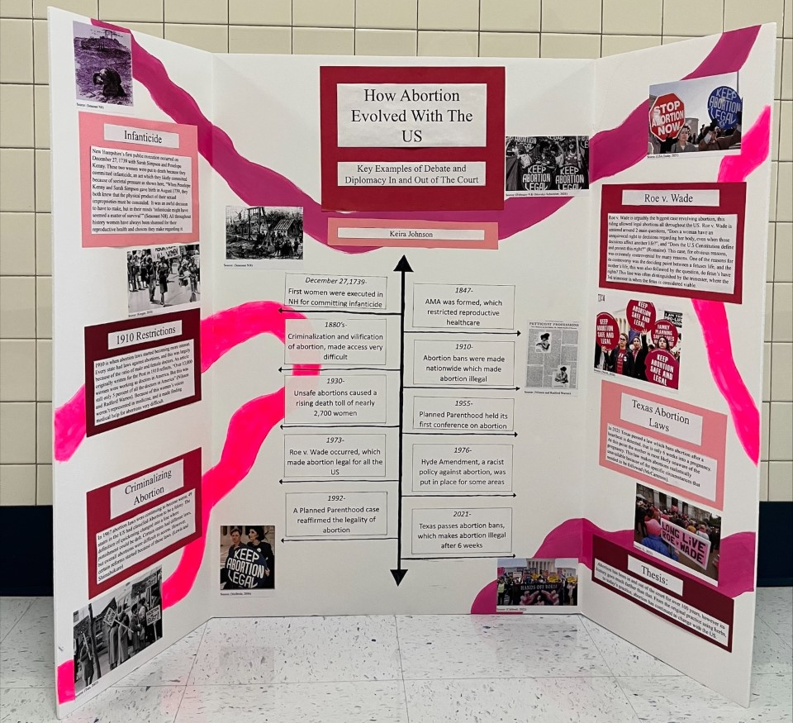

Slide 2
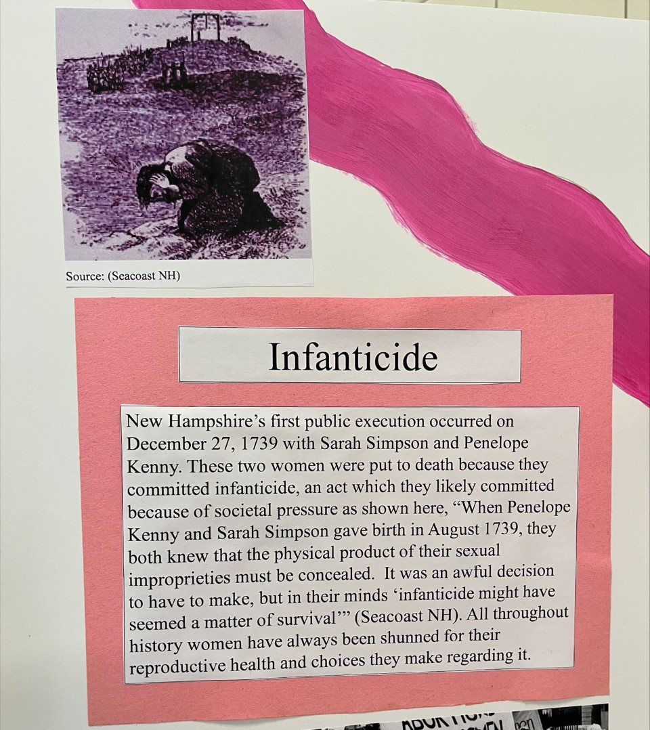
Source Credit Text: (Seacoast NH)

Slide 3
Infanticide
New Hampshire’s first public execution occurred on December 27, 1739 with Sarah Simpson and Penelope Kenny. These two women were put to death because they committed infanticide, an act which they likely committed because of societal pressure as shown here, “When Penelope Kenny and Sarah Simpson gave birth in August 1739, they both knew that the physical product of their sexual improprieties must be concealed. It was an awful decision to have to make, but in their minds ‘infanticide might have seemed a matter of survival’” (Seacoast NH). All throughout history women have always been shunned for their reproductive health and choices they make regarding it.

Slide 4
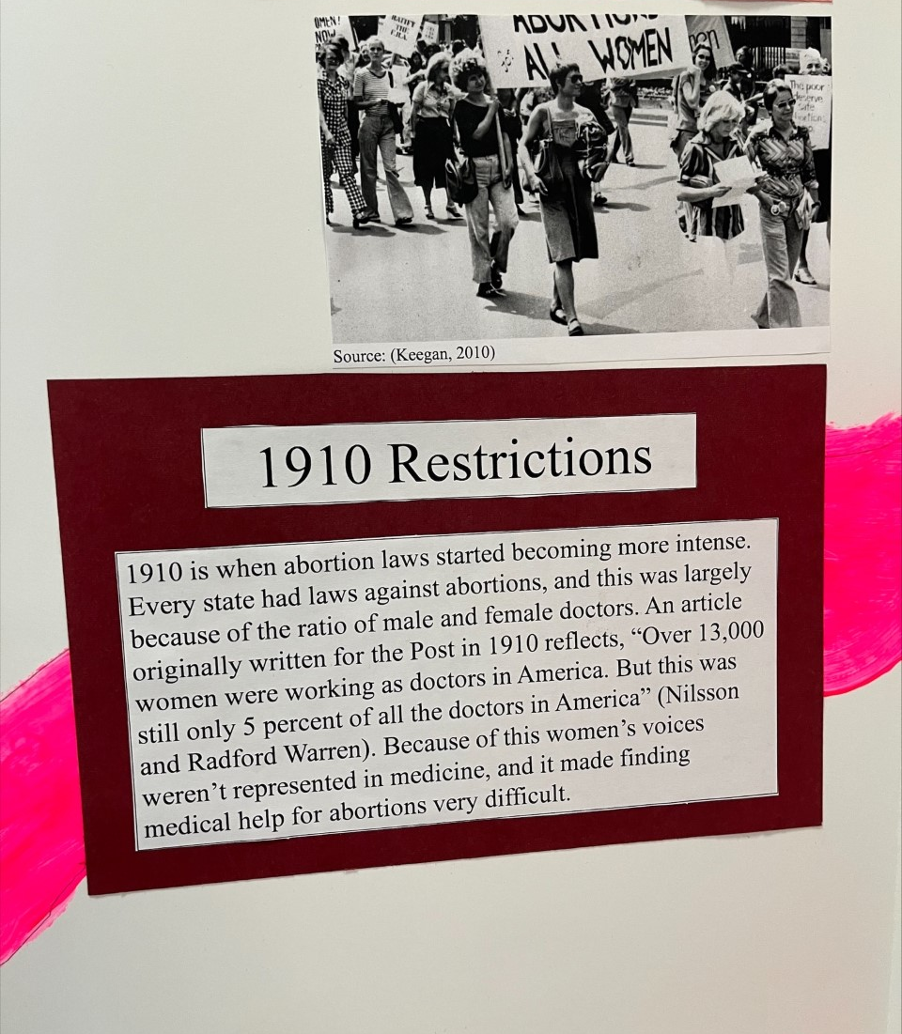
Source Credit Text: (Keegan, 2010)

Slide 5
1910 Restrictions
1910 is when abortion laws started becoming more intense. Every state had laws against abortions, and this was largely because of the ratio of male and female doctors. An article originally written for the Post in 1910 reflects, “Over 13,000 women were working as doctors in America. But this was still only 5 percent of all the doctors in America” (Nilsson and Radford Warren). Because of this women’s voices weren’t represented in medicine, and it made finding medical help for abortions very difficult.

Slide 6
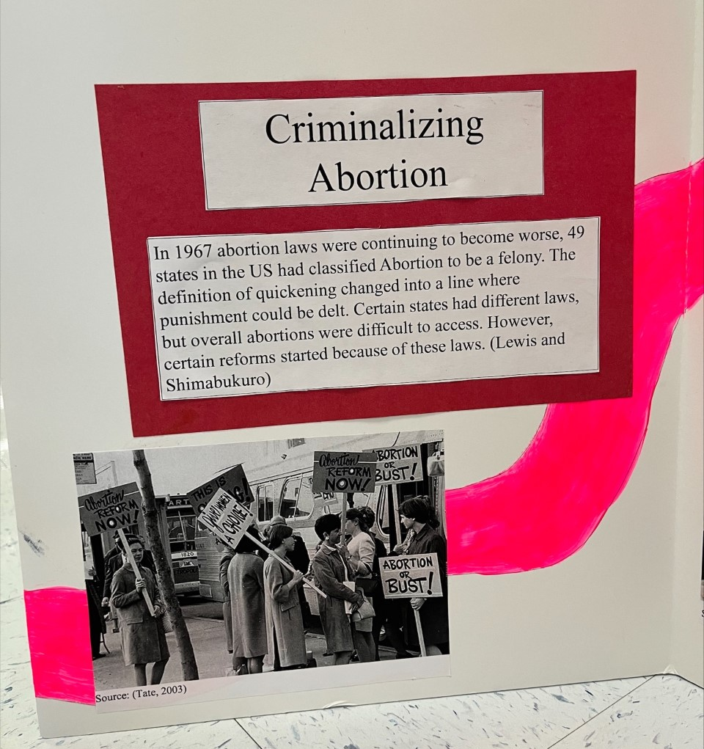
Source Credit Text: (Tate, 2003)

Slide 7
Criminalizing Abortion
In 1967 abortion laws were continuing to become worse, 49 states in the US had classified Abortion to be a felony. The definition of quickening changed into a line where punishment could be delt. Certain states had different laws, but overall abortions were difficult to access. However, certain reforms started because of these laws. (Lewis and Shimabukuro)

Slide 8
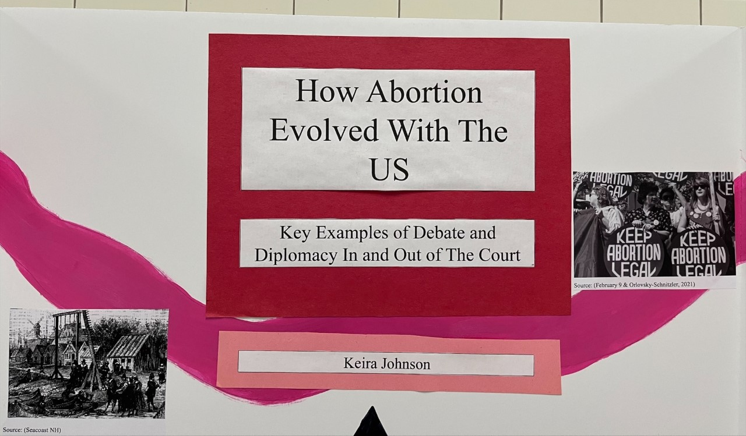
Source Credit Text: (February 9 & Orlovsky-Schnitzler, 2021)
(Seacoast NH)

Slide 9
How Abortion Evolved With The US
Key Examples of Debate and Diplomacy In and Out of The Court
Keira Johnson

Slide 10
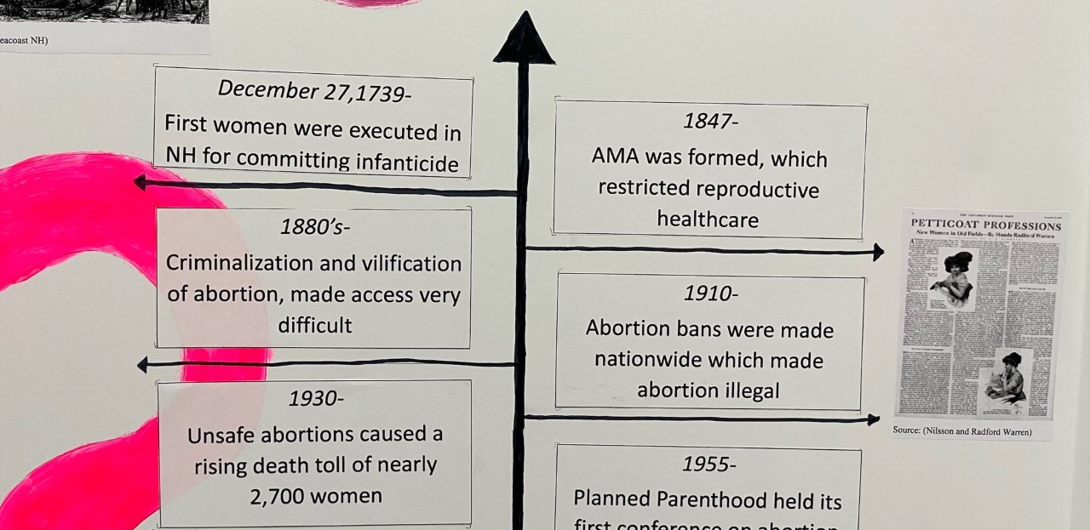
Source Credit Text: (Nilsson and Radford Warren)

Slide 11
December 27,1739-
First women were executed in NH for committing infanticide
1847-
AMA was formed, which restricted reproductive healthcare
1880’s-
Criminalization and vilification of abortion, made access very difficult
1910-
Abortion bans were made nationwide which made abortion illegal
1930-
Unsafe abortions caused a rising death toll of nearly 2,700 women

Slide 12
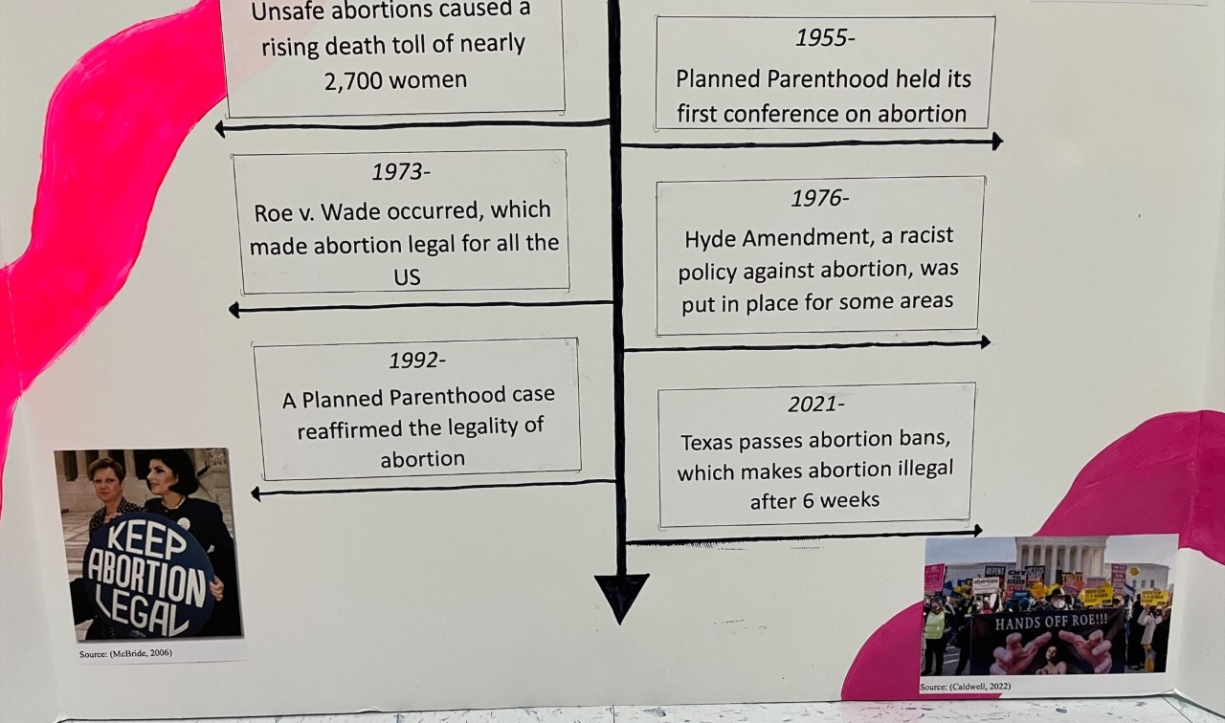
Source Credit Text: (McBride, 2006)
(Caldwell, 2022)

Slide 13
1955-
Planned Parenthood held its first conference on abortion
1973-
Roe v. Wade occurred, which made abortion legal for all the US
1976-
Hyde Amendment, a racist policy against abortion, was put in place for some areas
1992-
A Planned Parenthood case reaffirmed the legality of abortion
2021-
Texas passes abortion bans, which makes abortion illegal after 6 weeks

Slide 14
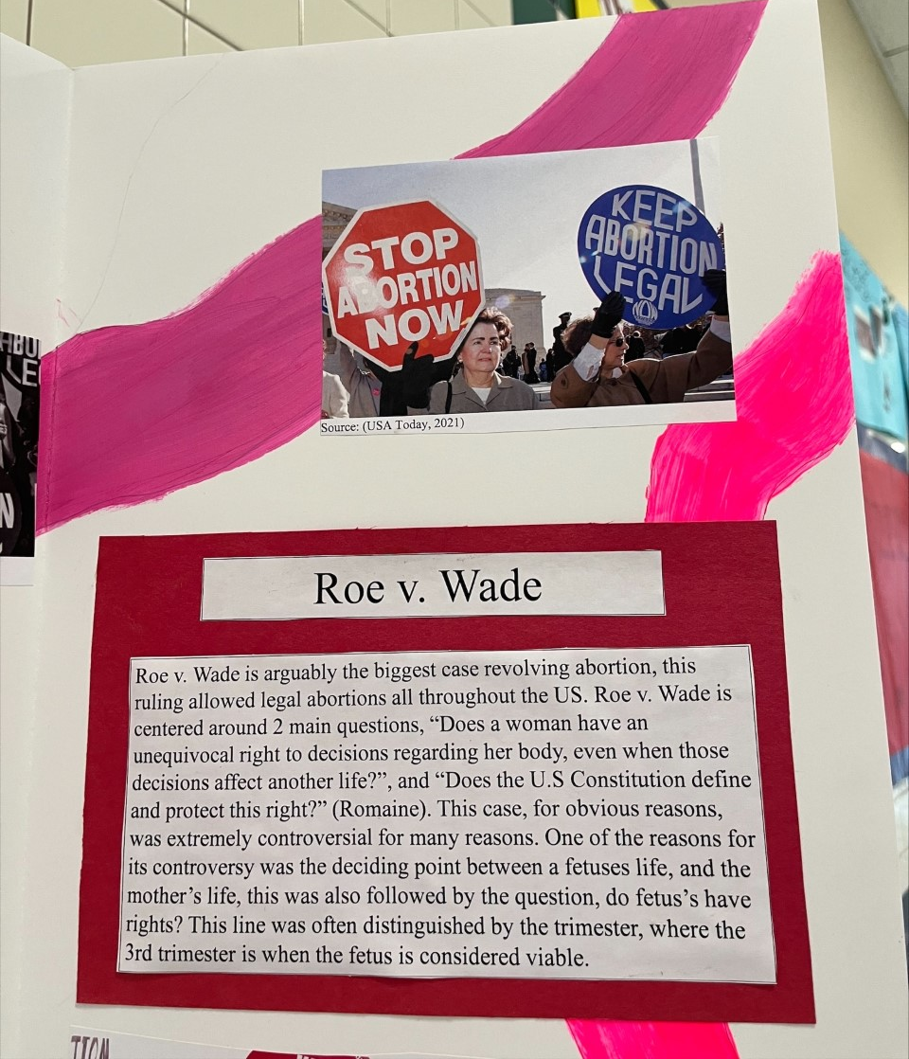
Source Credit Text: (USA Today, 2021)

Slide 15
Roe v. Wade
Roe v. Wade is arguably the biggest case revolving abortion, this ruling allowed legal abortions all throughout the US. Roe v. Wade is centered around 2 main questions, “Does a woman have an unequivocal right to decisions regarding her body, even when those decisions affect another life?”, and “Does the U.S Constitution define and protect this right?” (Romaine). This case, for obvious reasons, was extremely controversial for many reasons. One of the reasons for its controversy was the deciding point between a fetuses life, and the mother’s life, this was also followed by the question, do fetus’s have rights? This line was often distinguished by the trimester, where the 3rd trimester is when the fetus is considered viable.

Slide 16
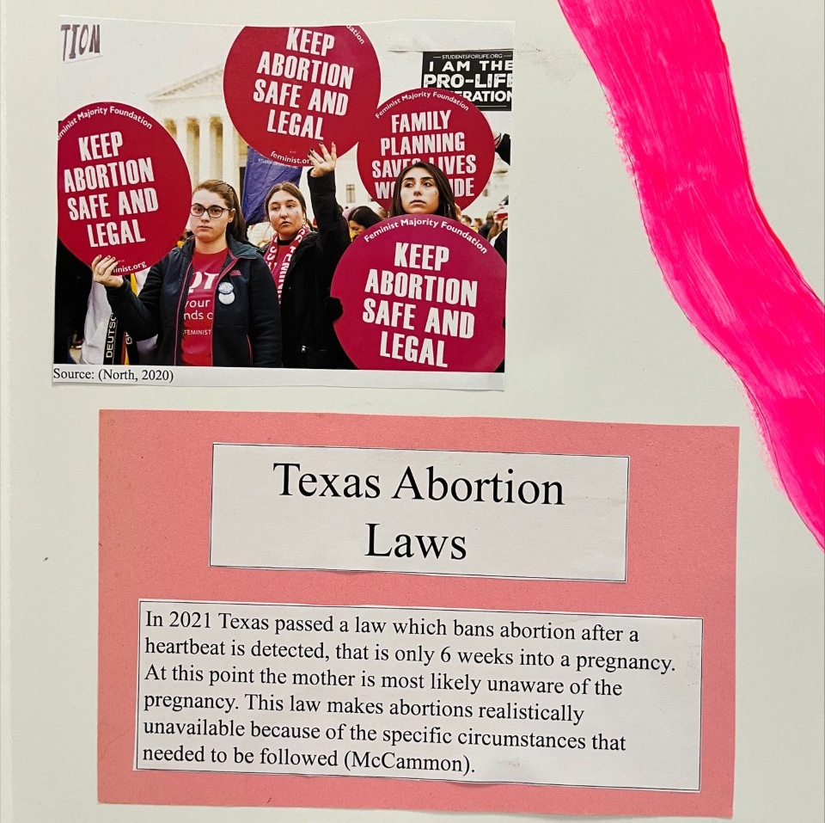
Source Credit Text: (North, 2020)

Slide 17
Texas Abortion Laws
In 2021 Texas passed a law which bans abortion after a heartbeat is detected, that is only 6 weeks into a pregnancy. At this point the mother is most likely unaware of the pregnancy. This law makes abortions realistically unavailable because of the specific circumstances that needed to be followed (McCammon).

Slide 18
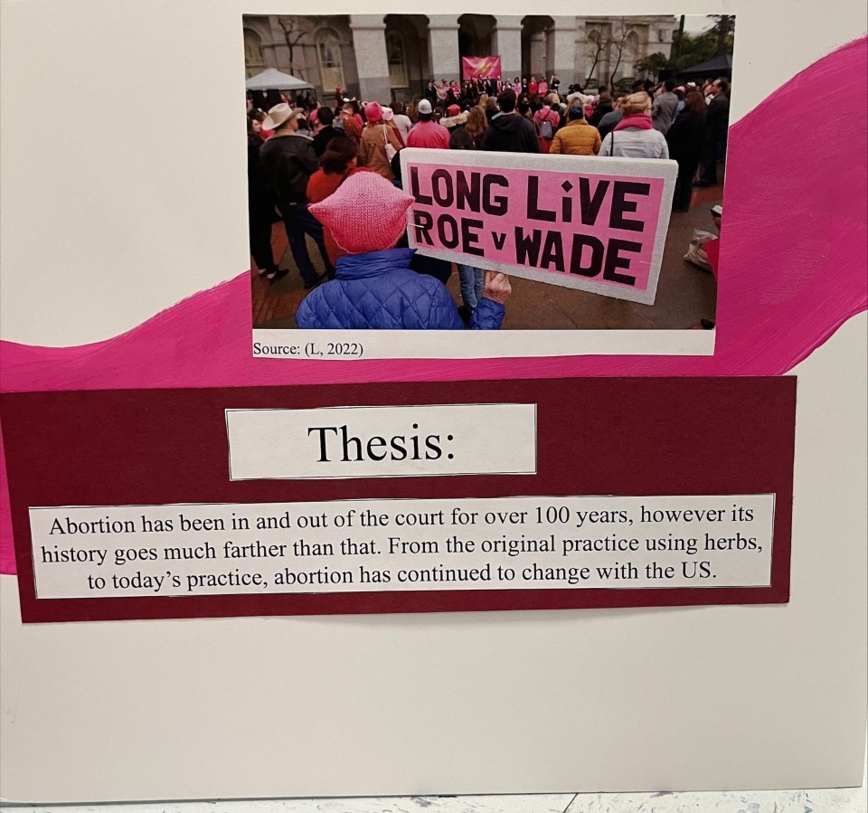
Source Credit Text: (L, 2022)

Slide 19
Thesis:
Abortion has been in and out of the court for over 100 years, however its history goes much farther than that. From the original practice using herbs, to today’s practice, abortion has continued to change with the US.

